Slide 1
48-spot smFRET
with ALTERNATION
WeissLab GM 2017-04-24
Antonino Ingargiola

Slide 2
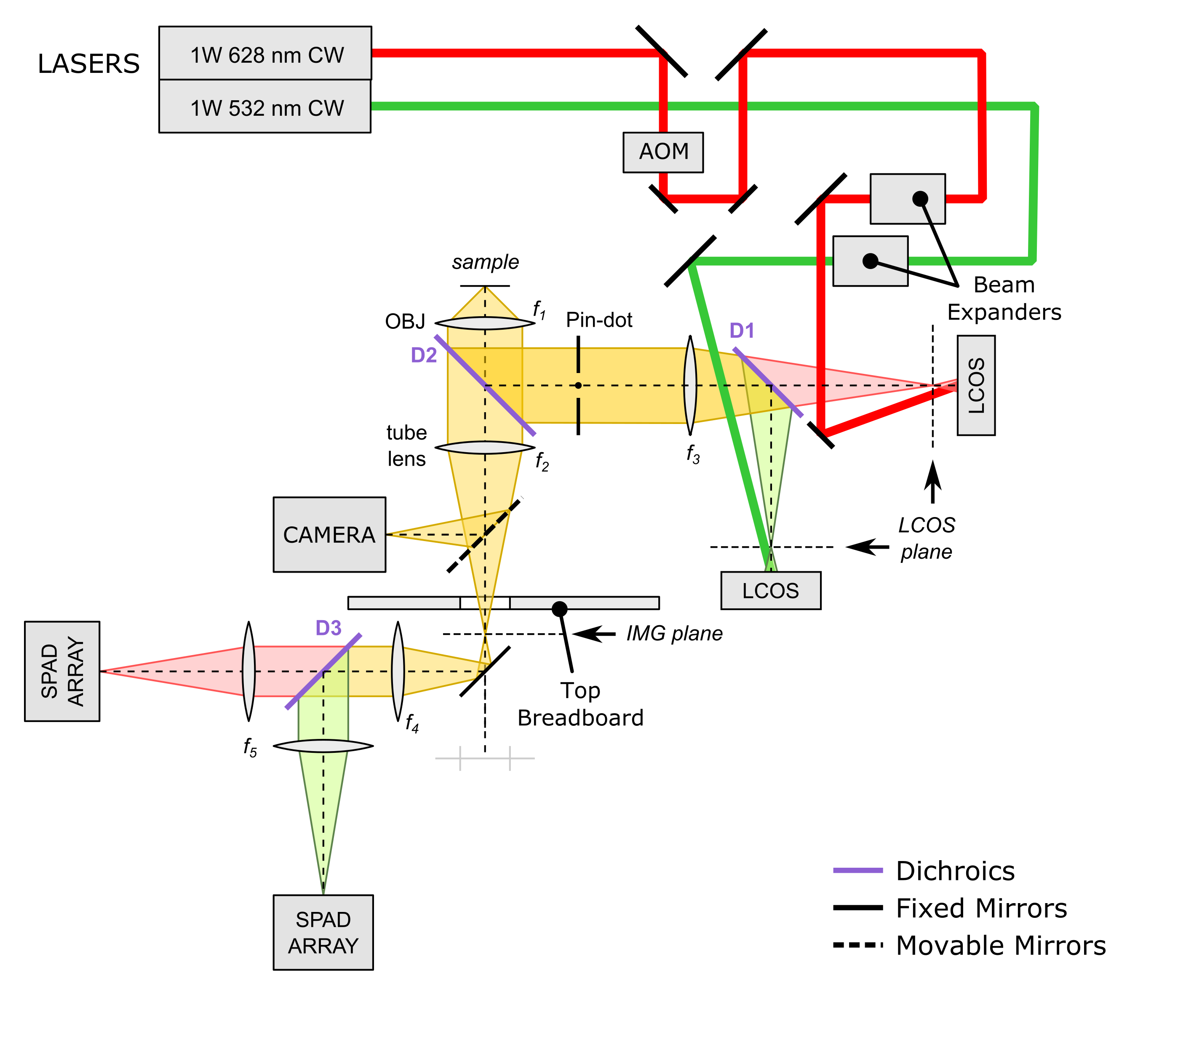
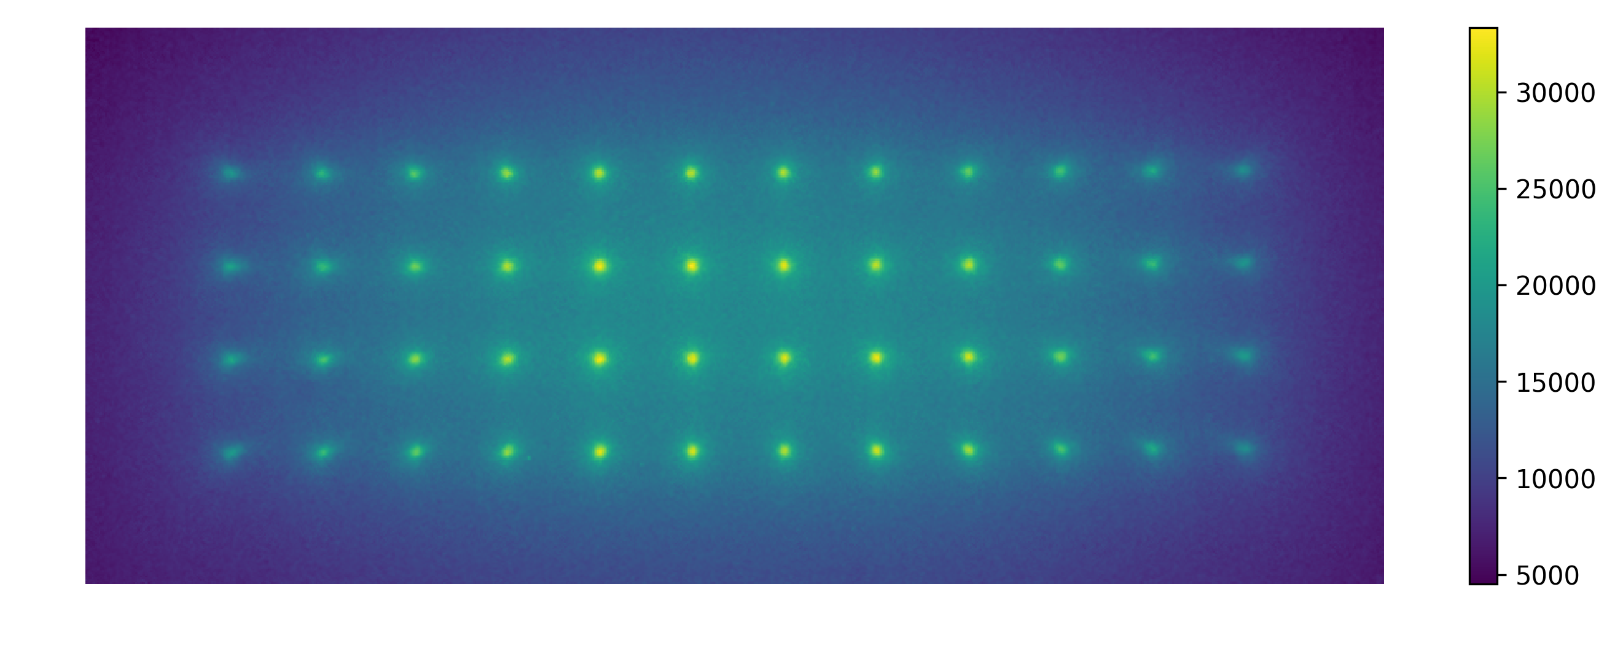
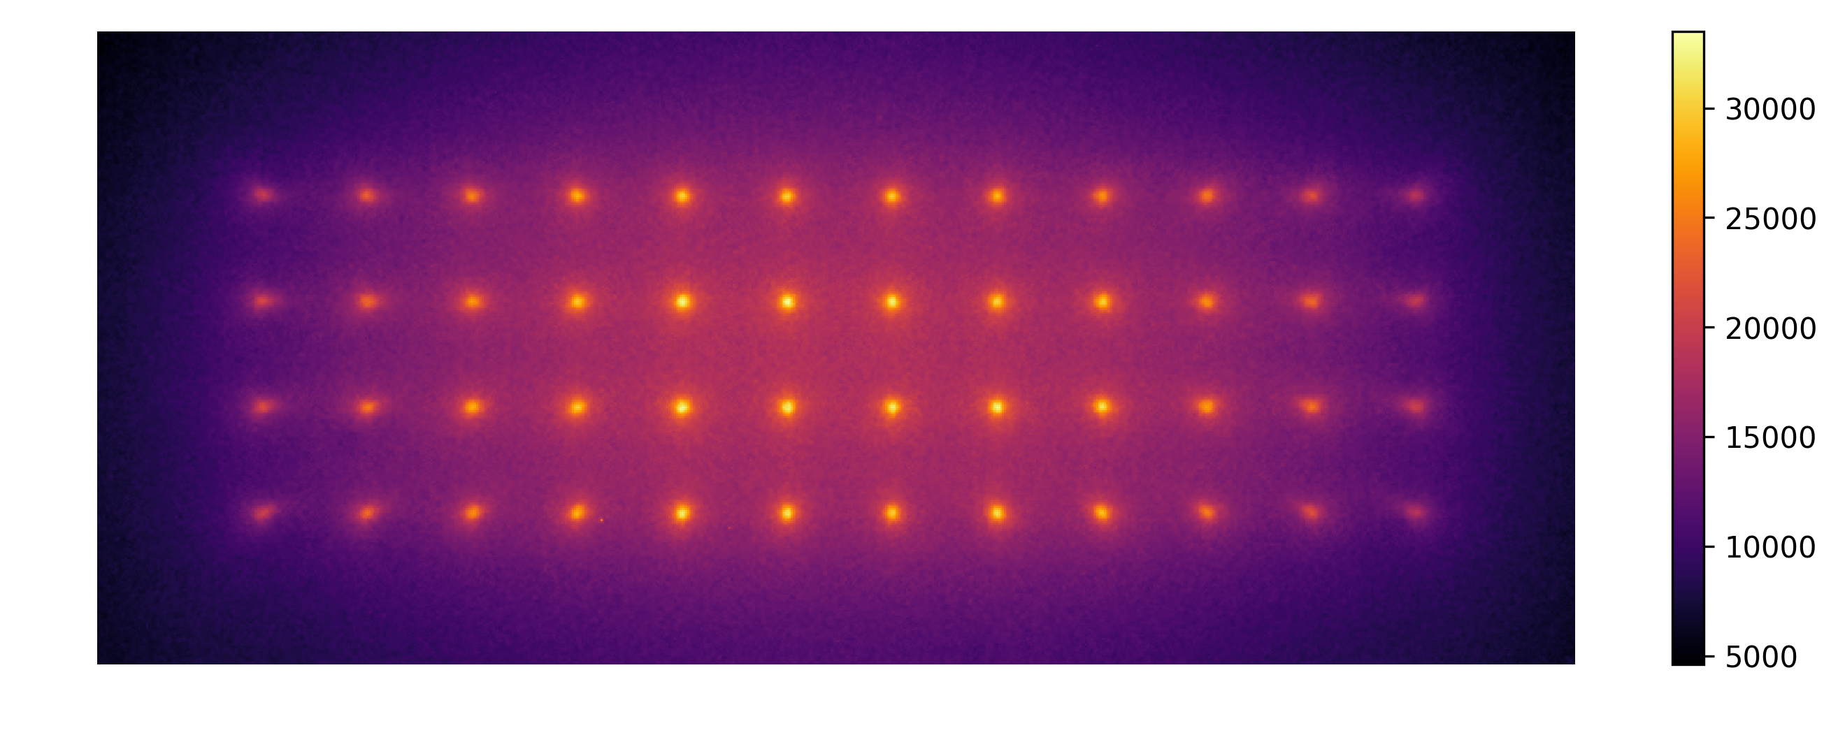
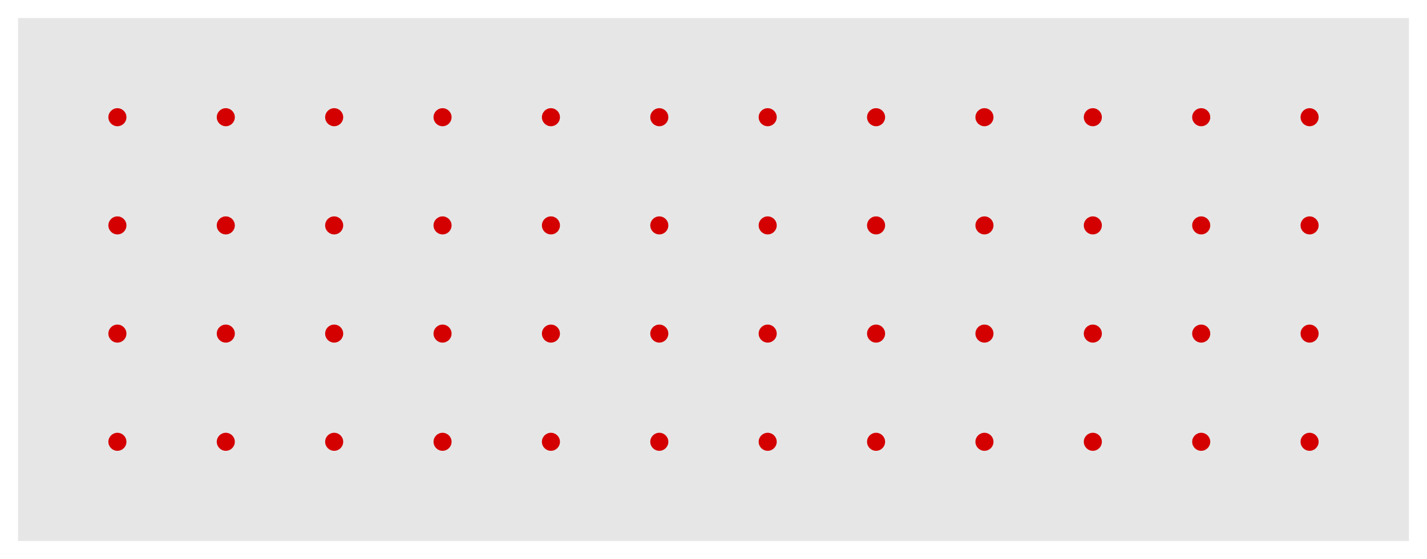
Excitation
Detection

Slide 3
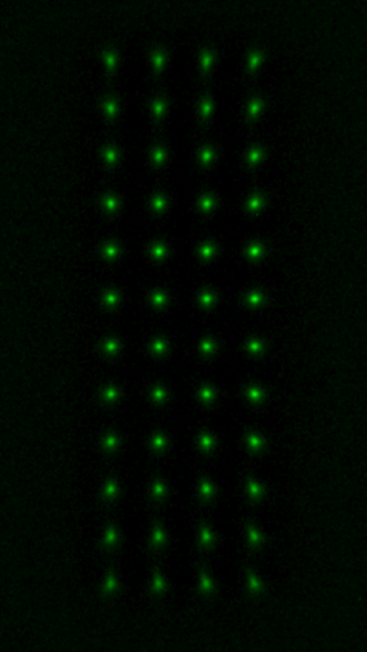
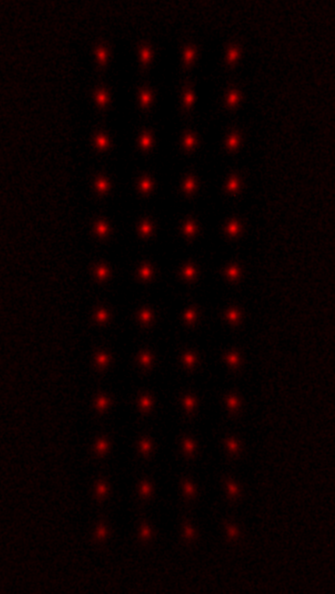
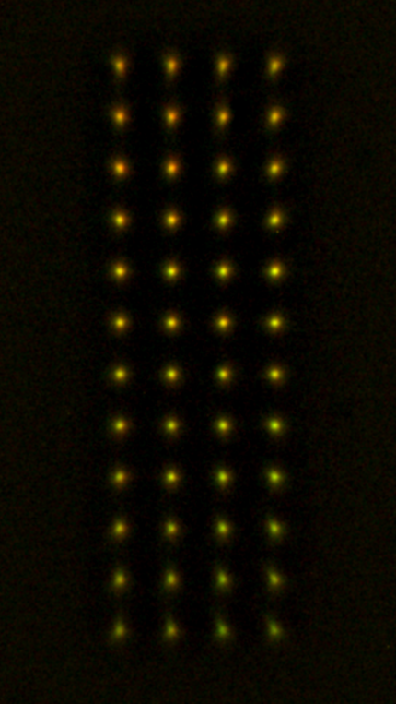
532nm Excitation
628nm Excitation
Composite

Slide 4
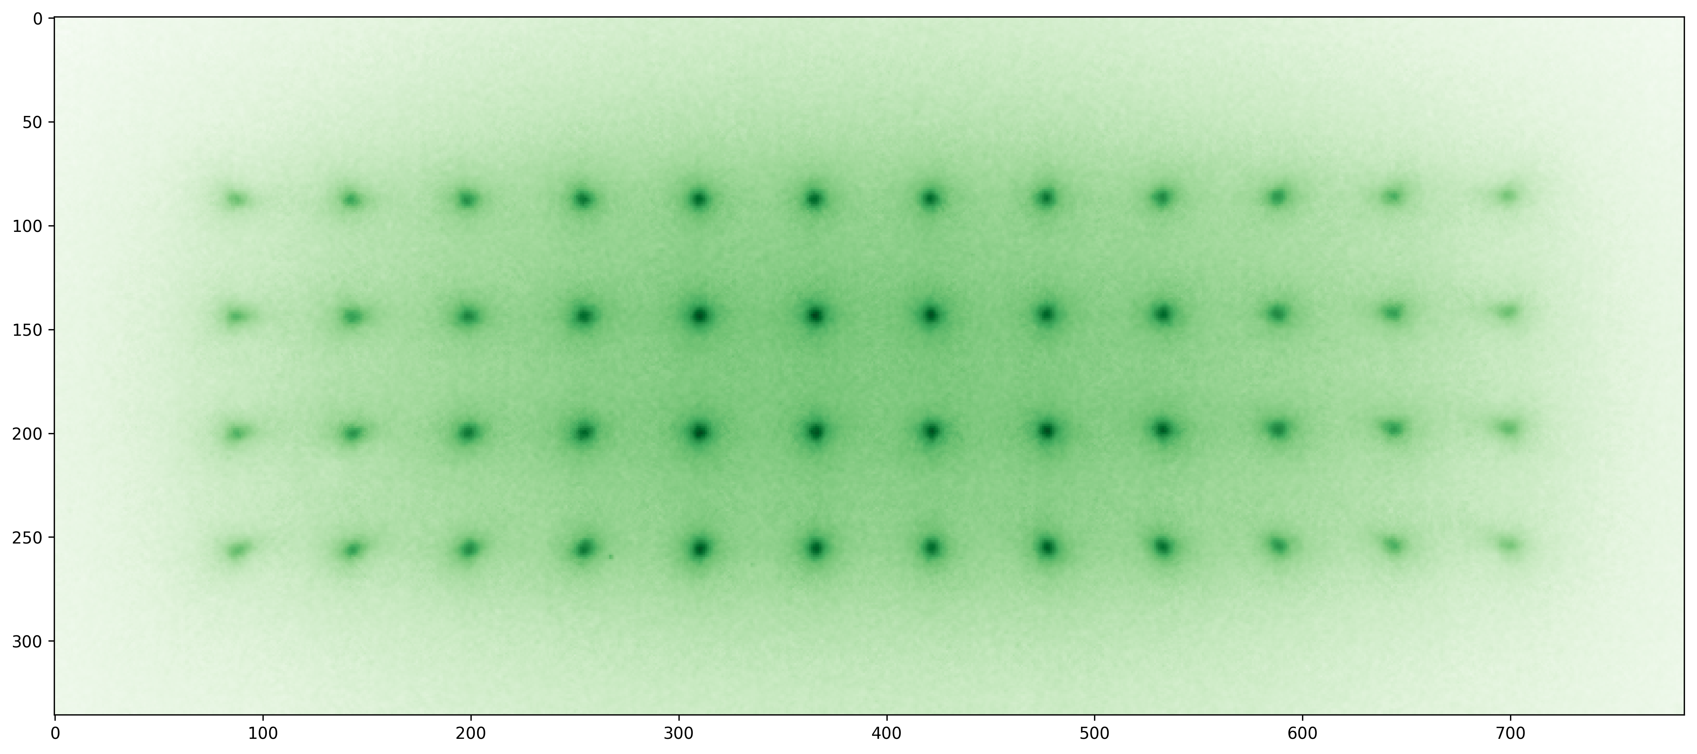
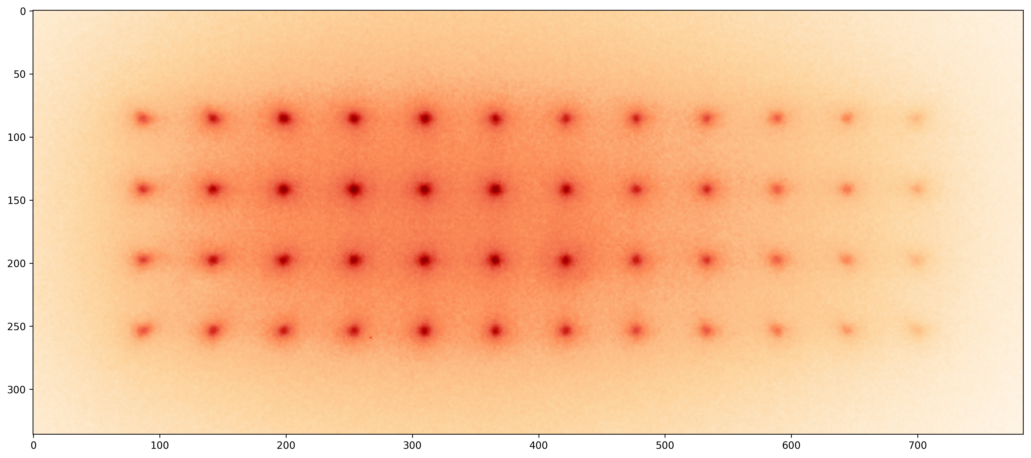
532nm
Excitation
628nm
Excitation

Slide 5
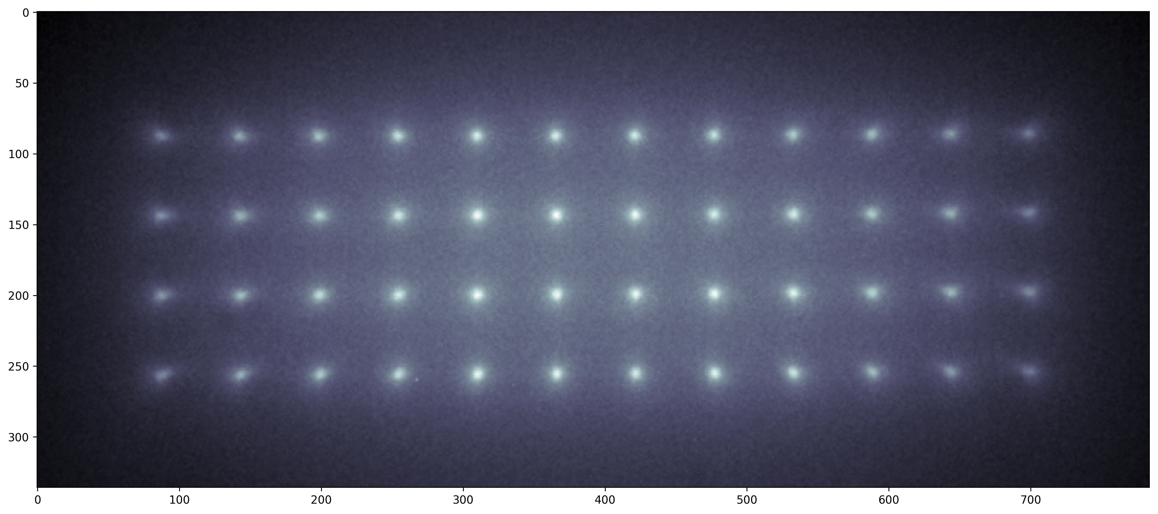
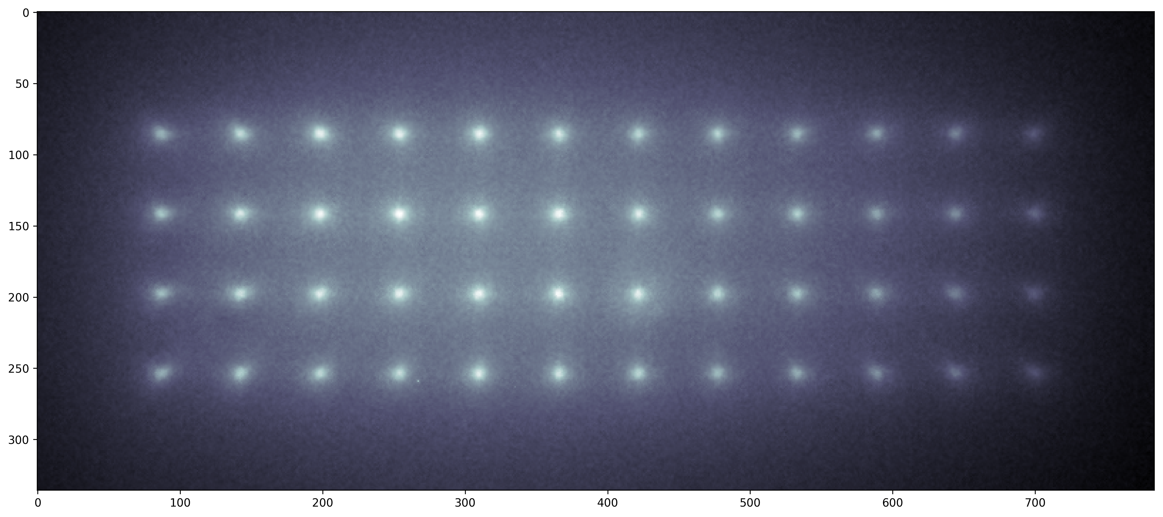
532nm
Excitation
628nm
Excitation

Slide 6
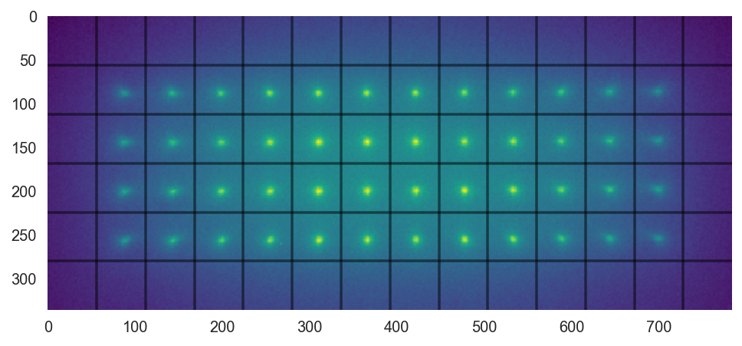
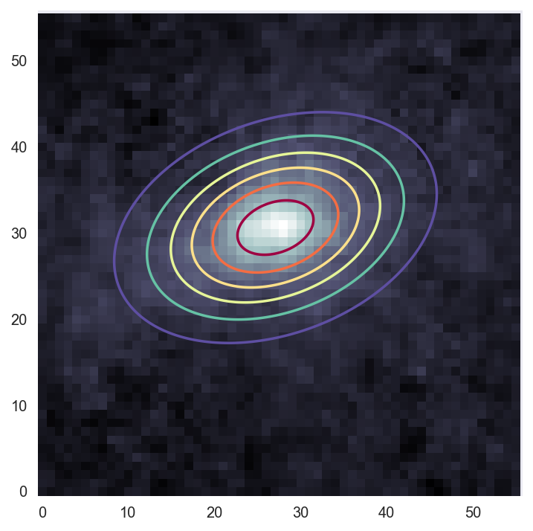
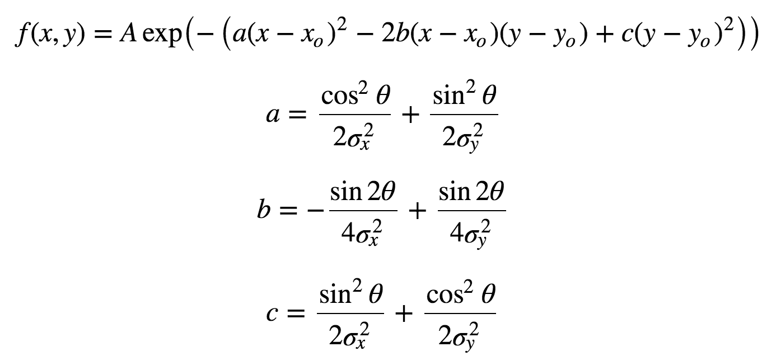
Pattern fitting
2D Gaussian fit

Slide 7
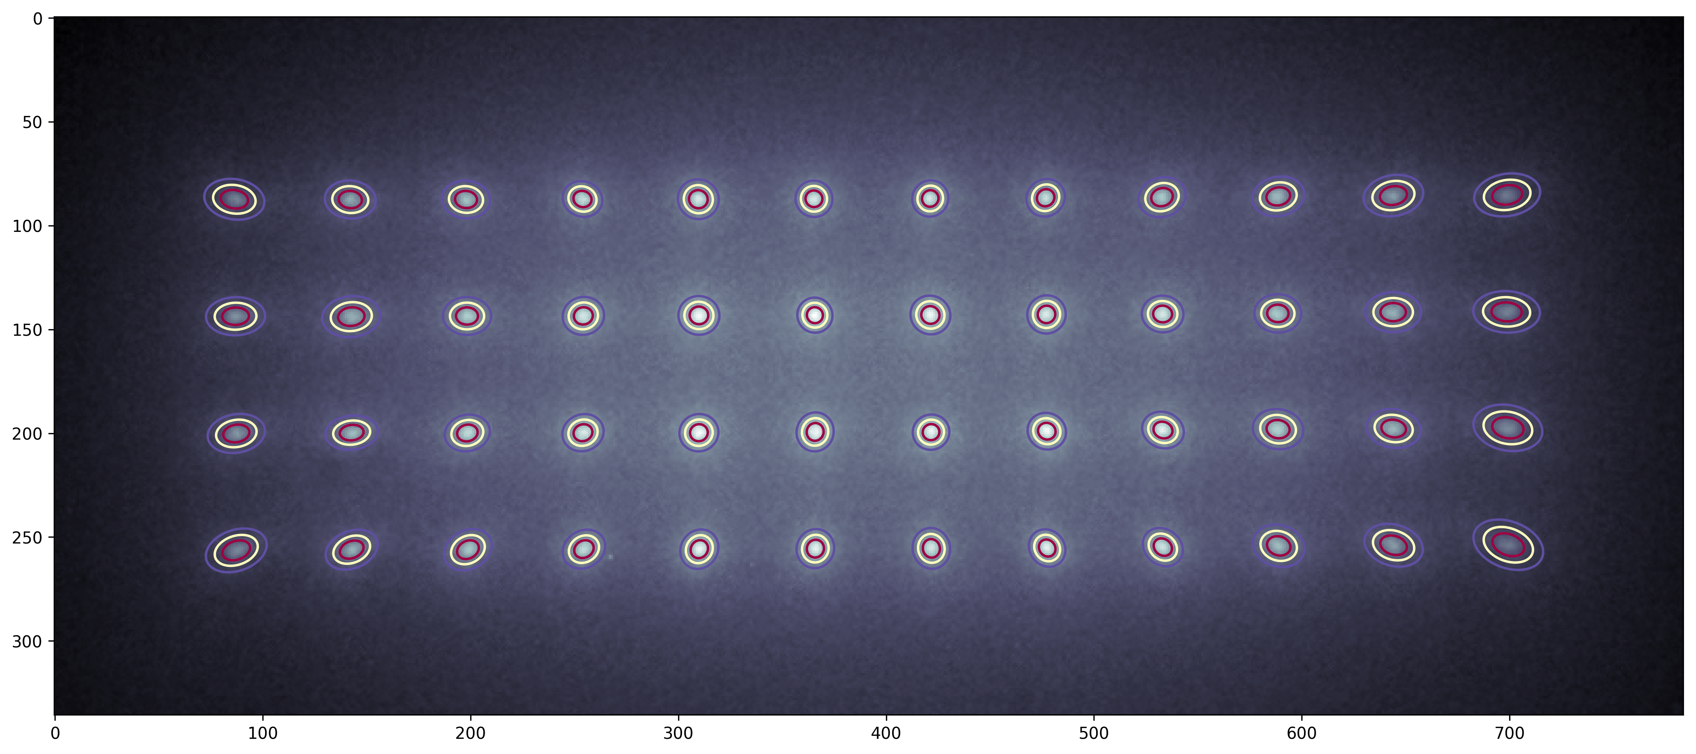
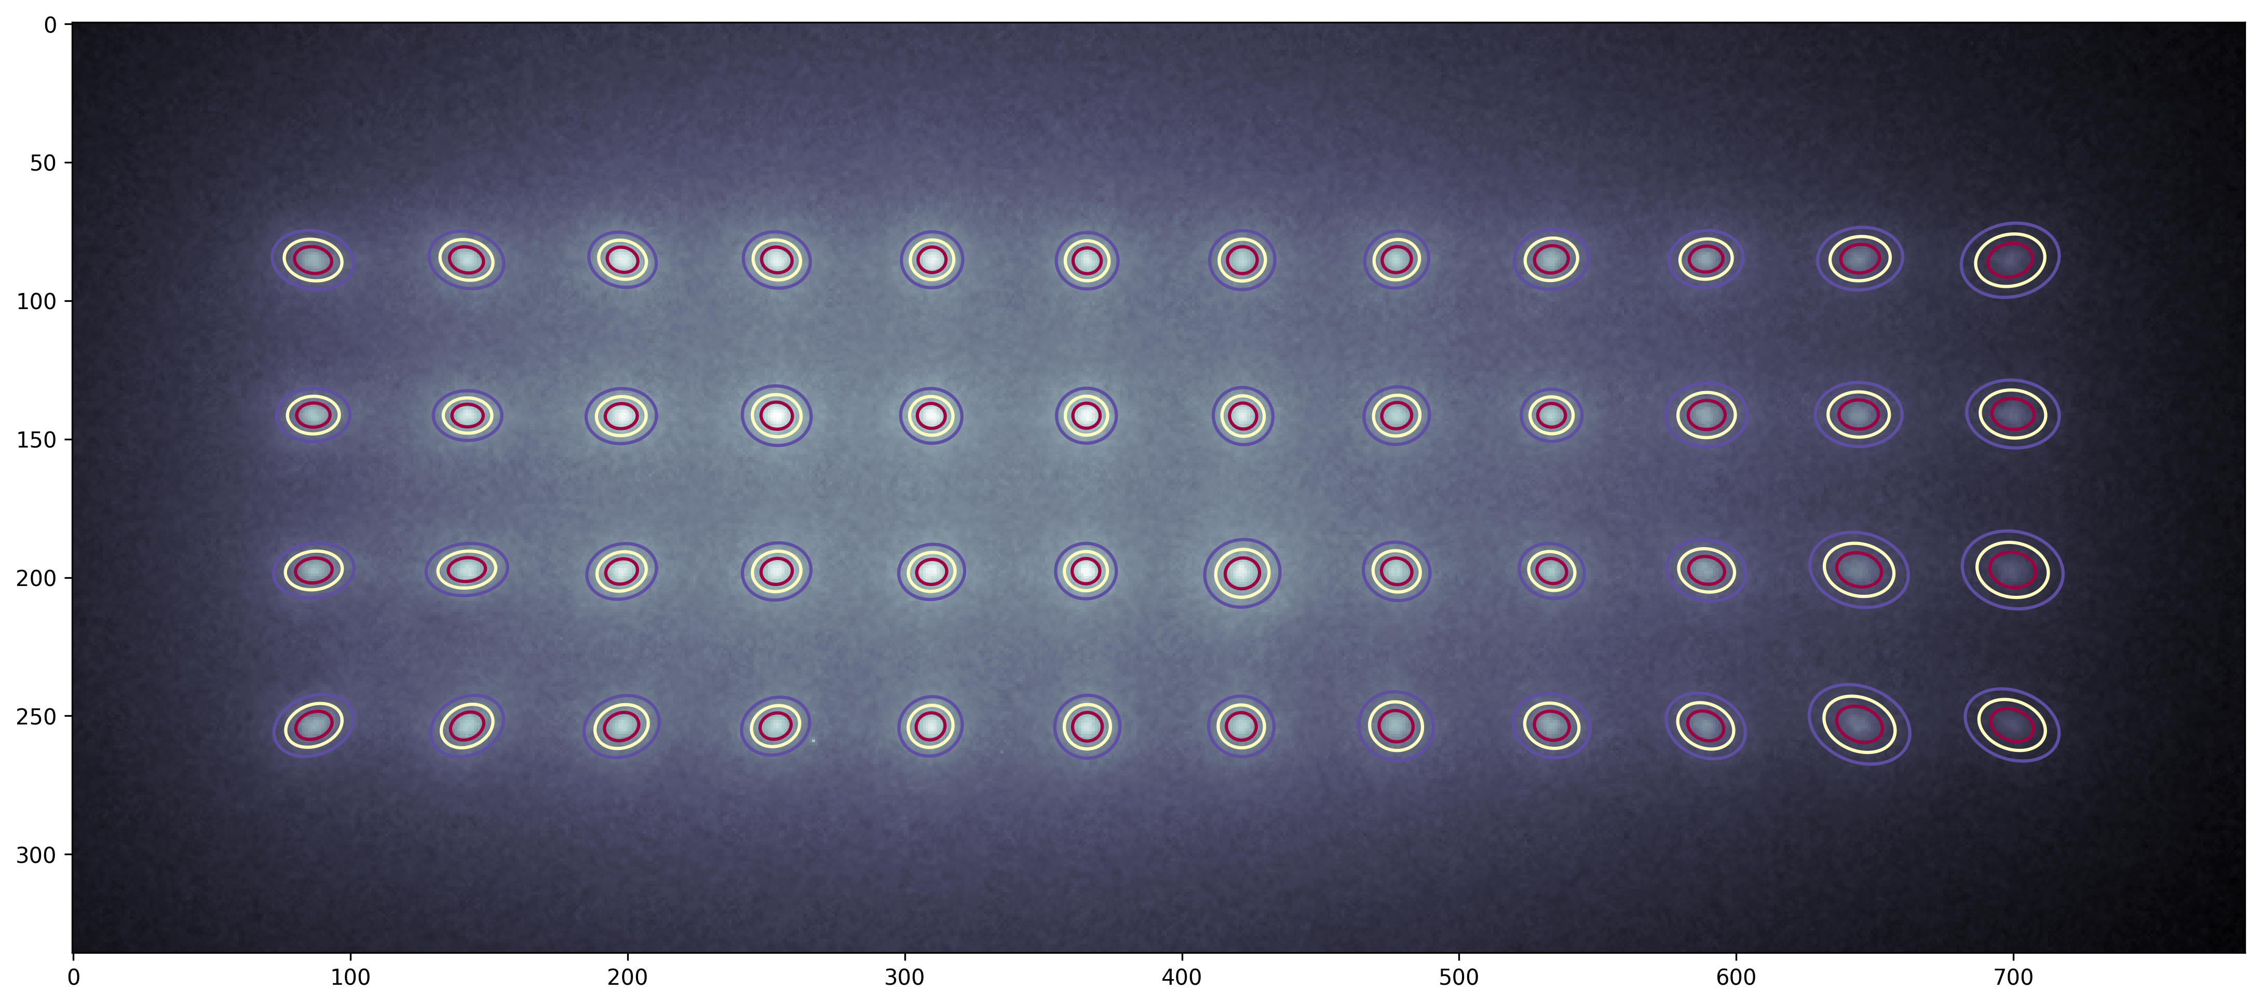
532nm
Excitation
628nm
Excitation

Slide 8
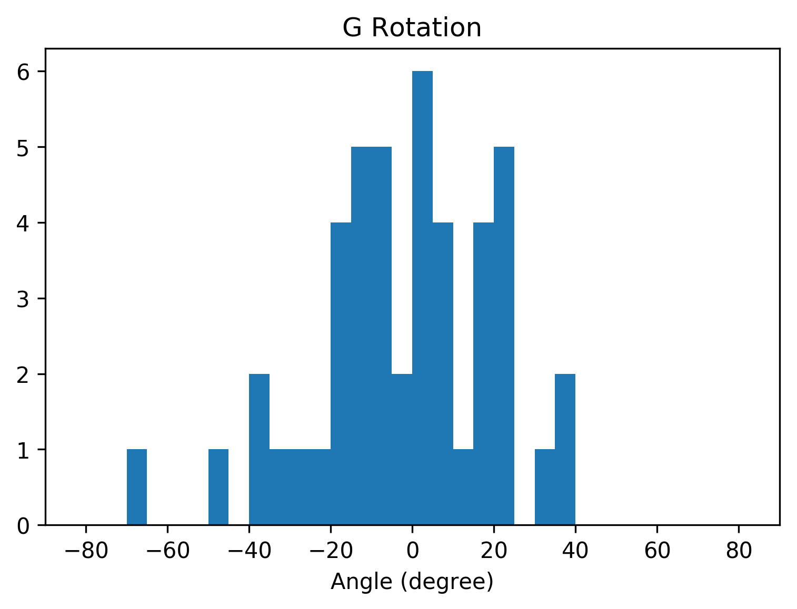
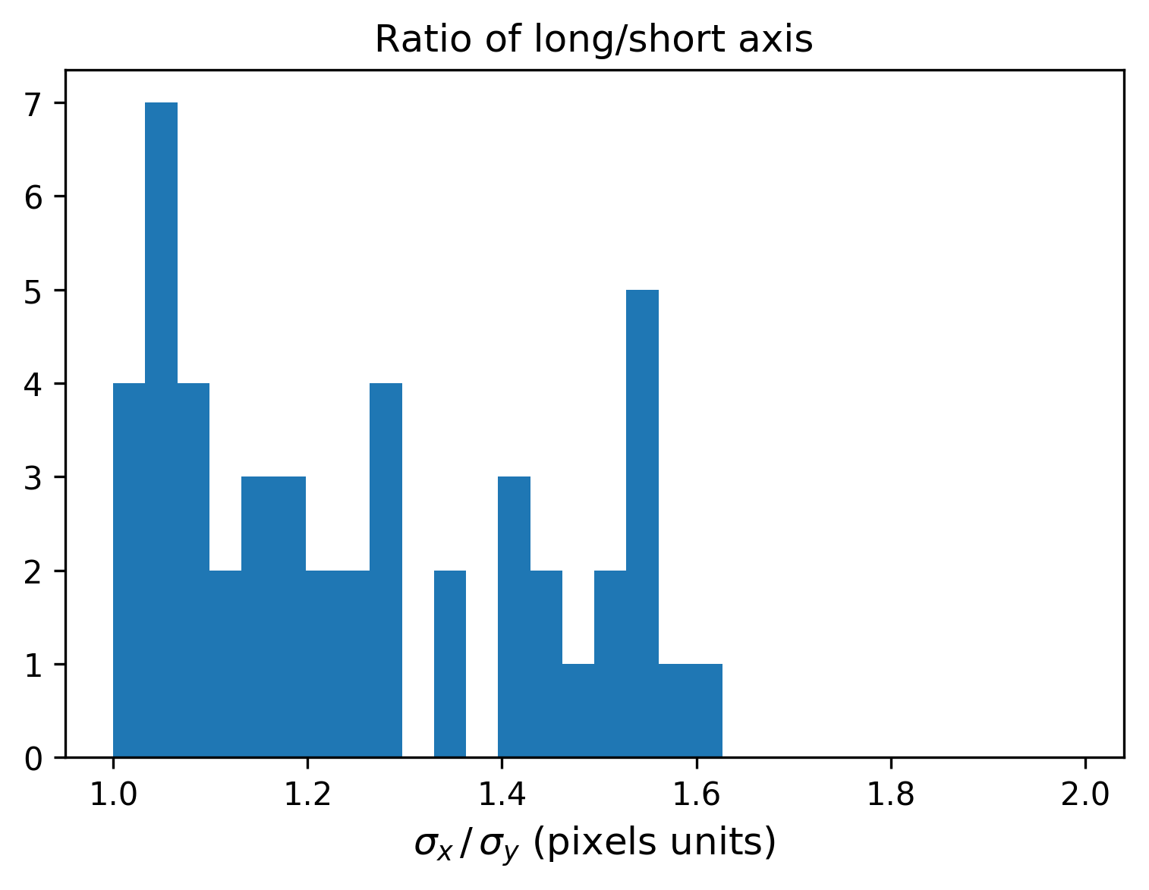
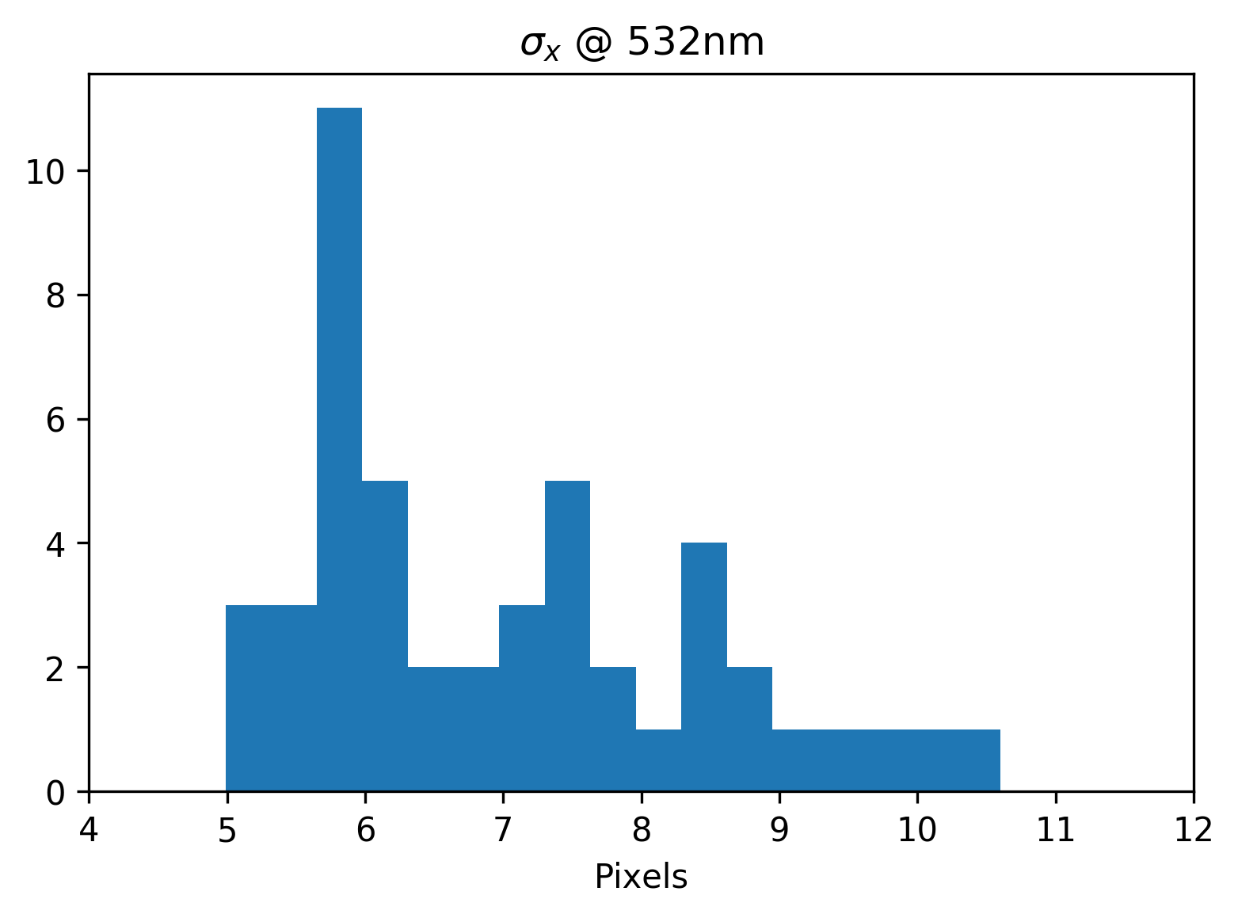
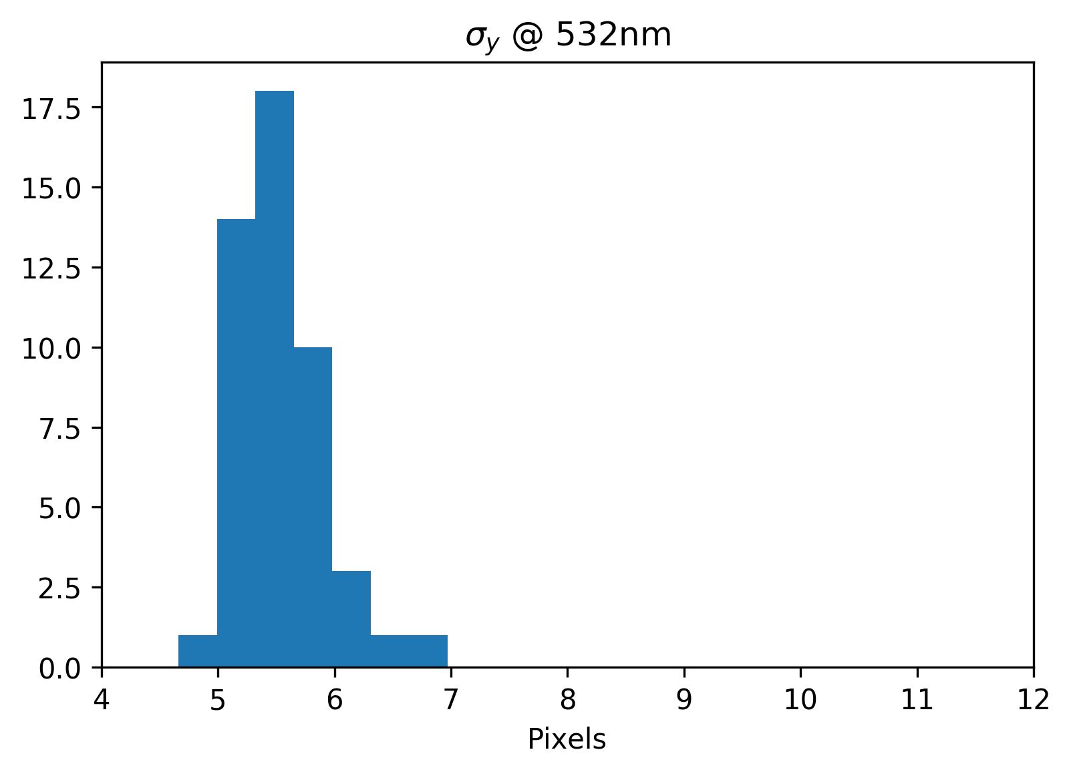
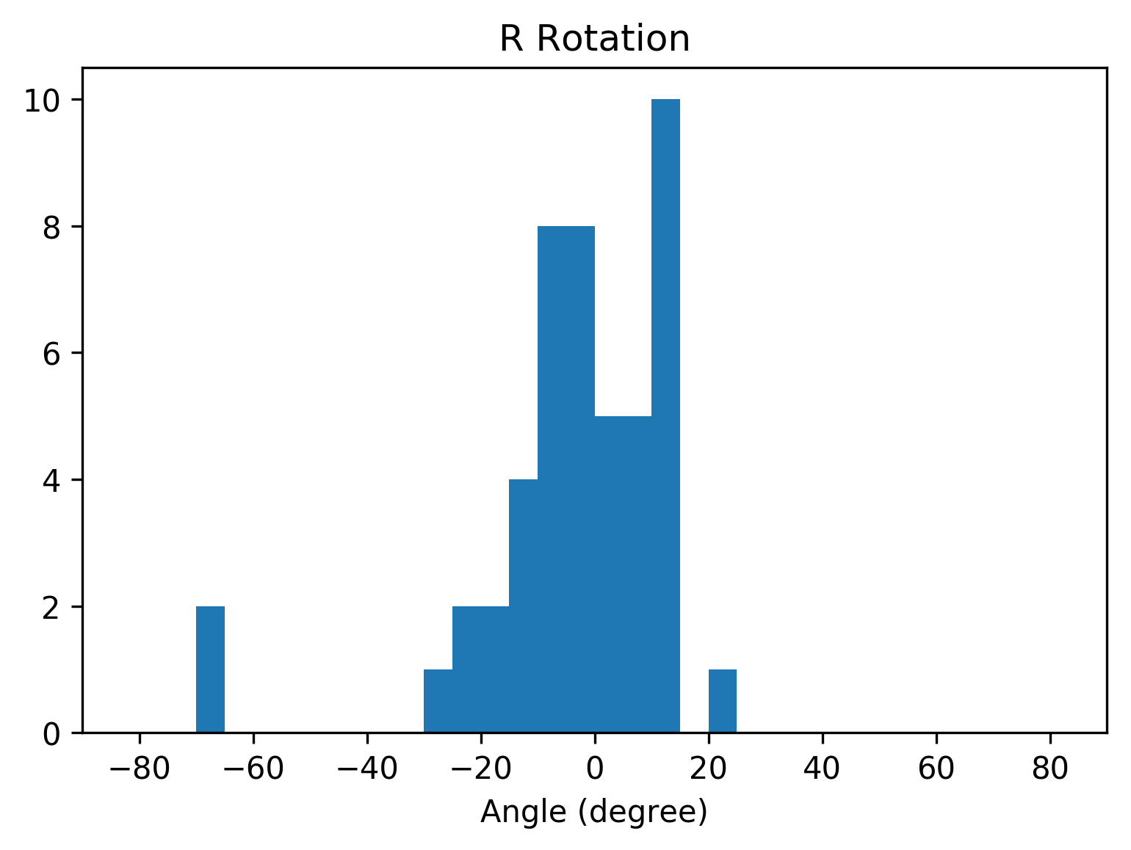
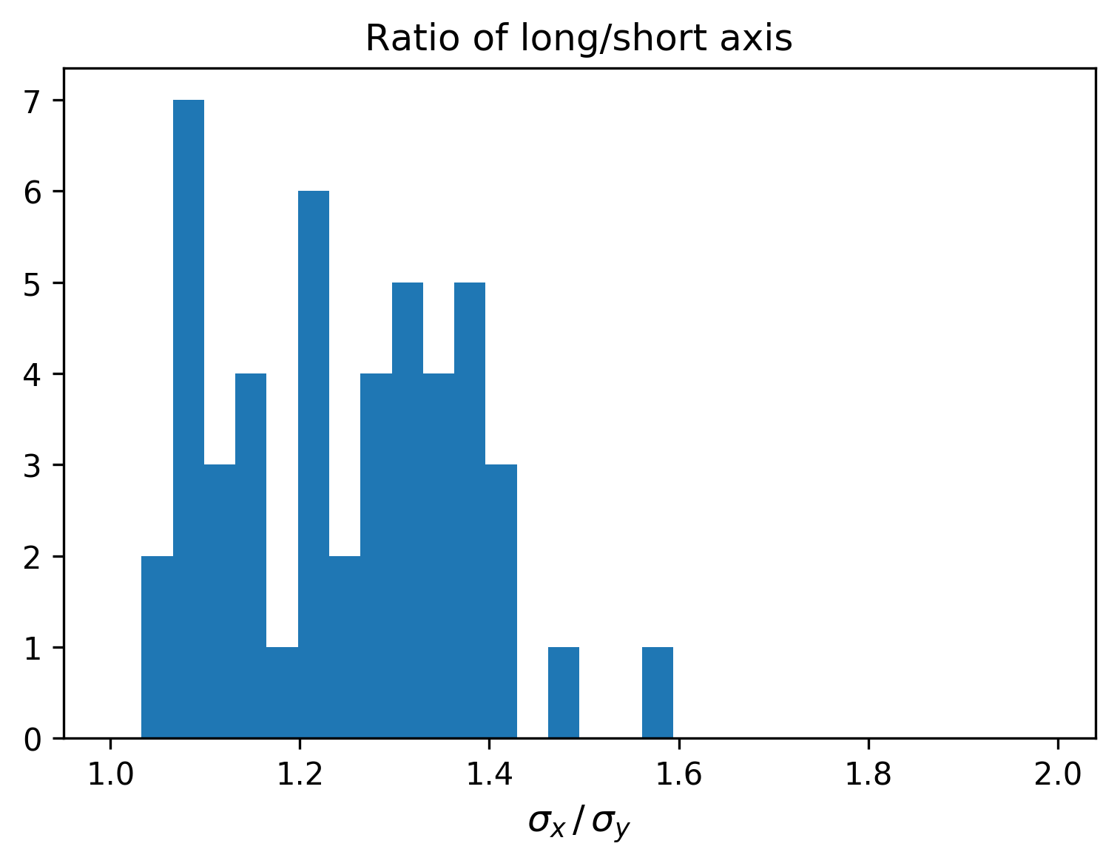
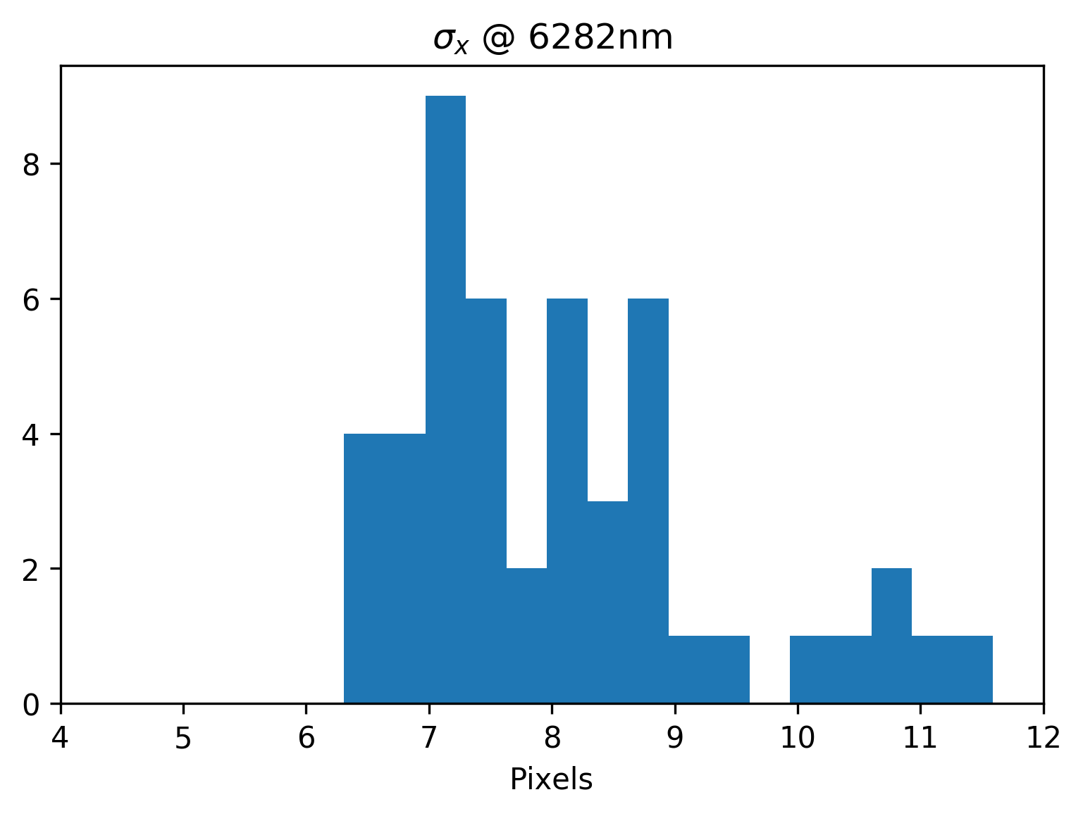
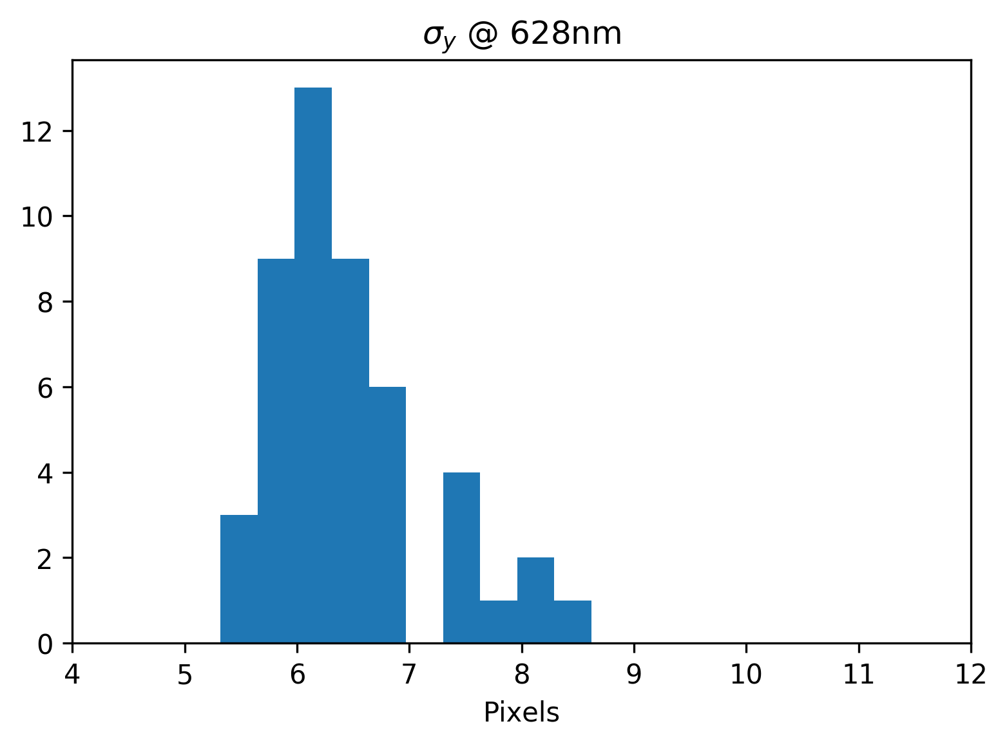
Pattern Statistics: fitted parameters distributions
532nm Excitation
628nm Excitation

Slide 9
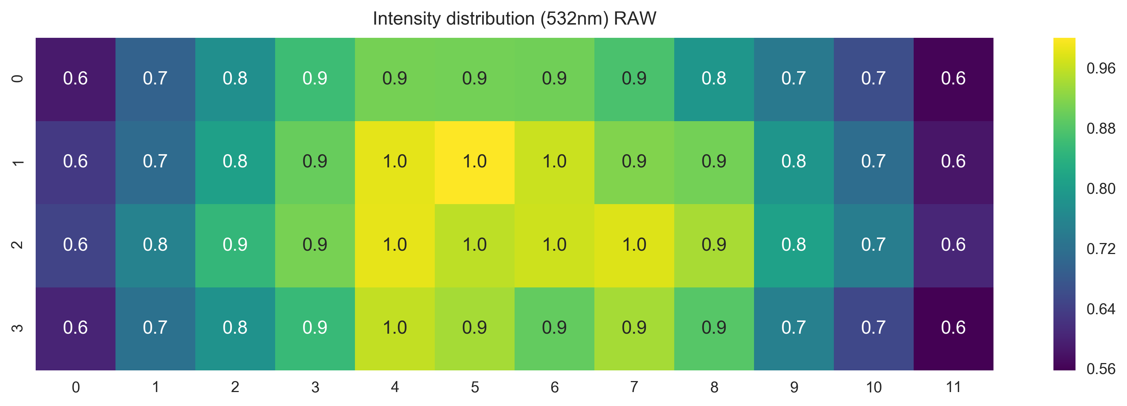
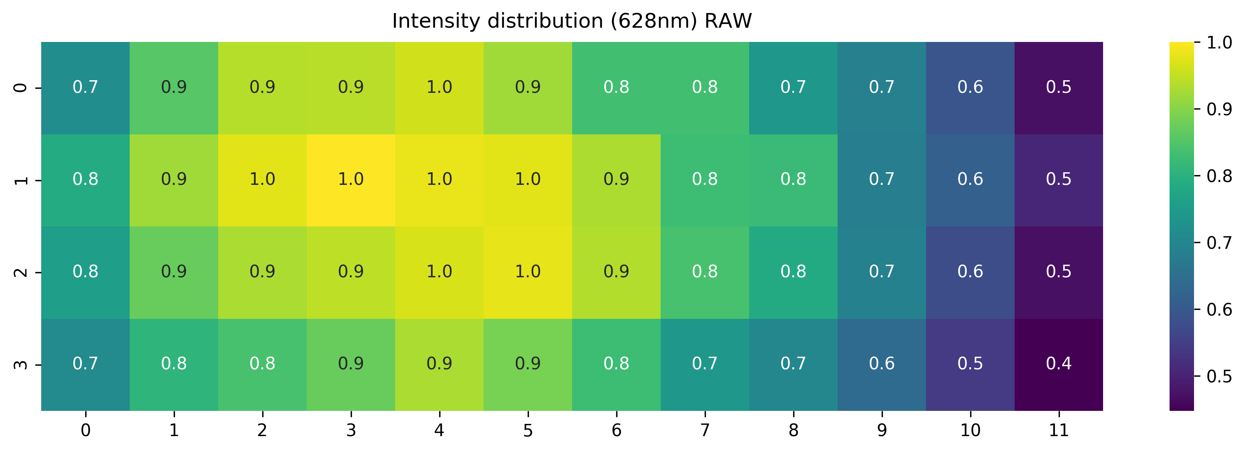
Pattern Statistics: raw intensity distribution

Slide 10
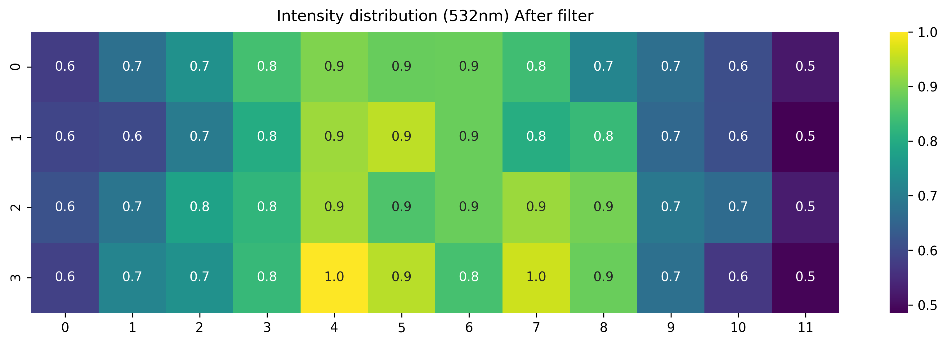
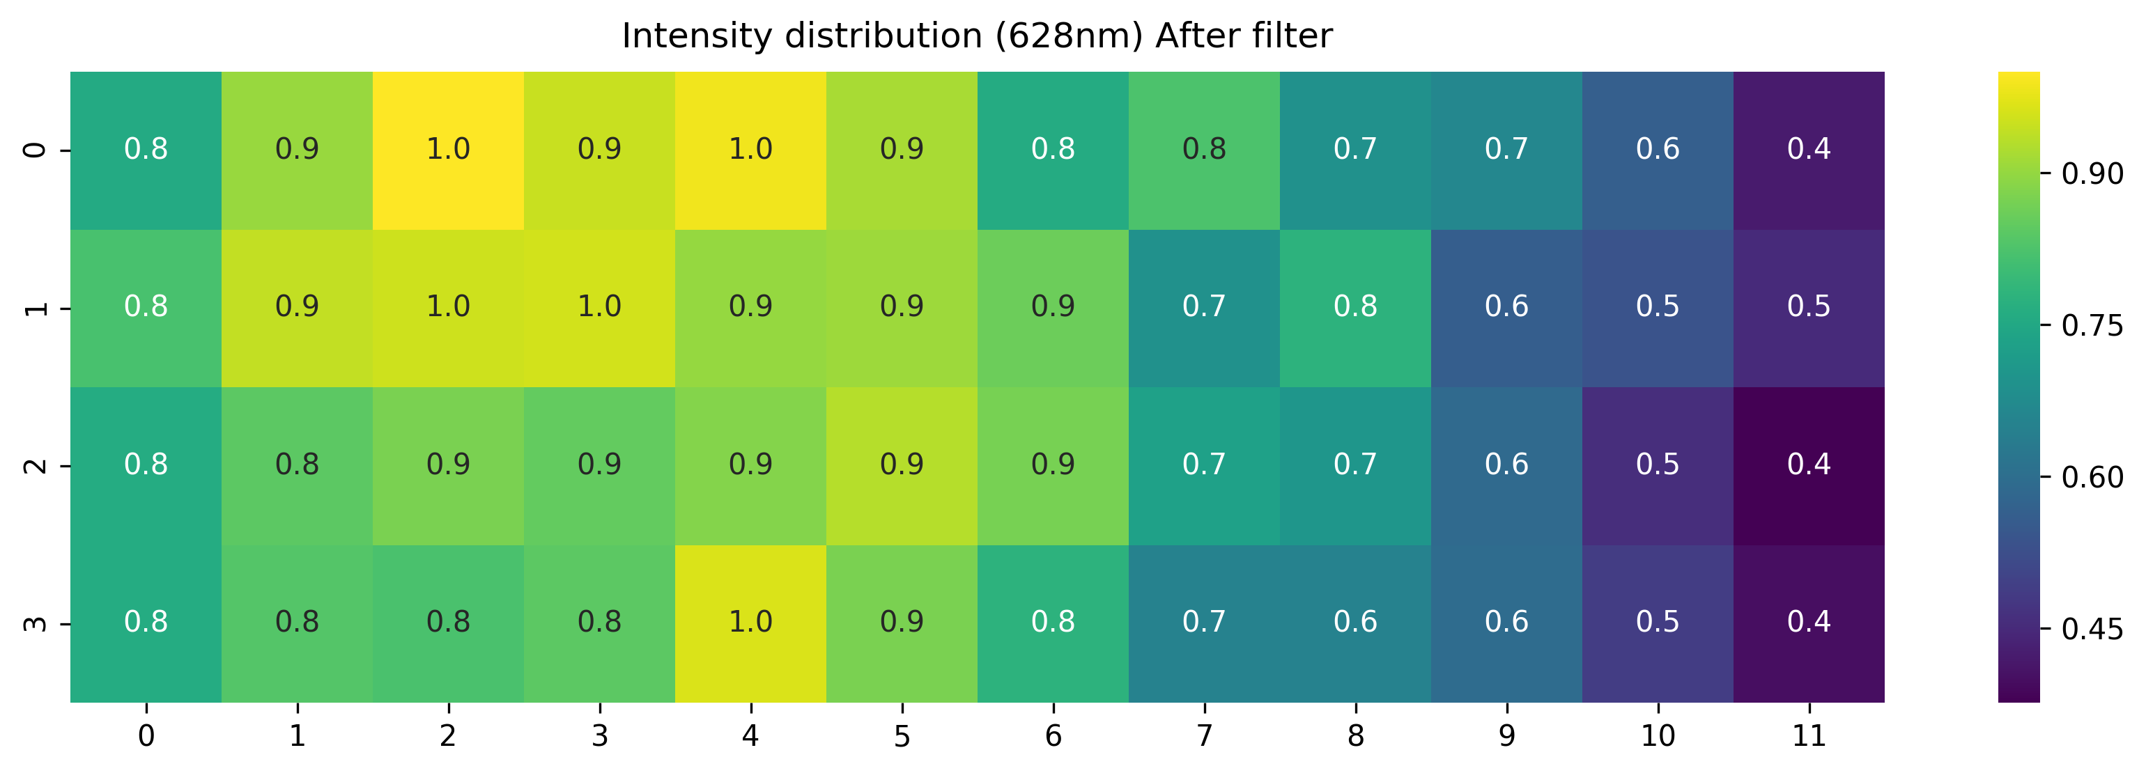
Pattern Statistics: sigma-x distribution

Slide 11
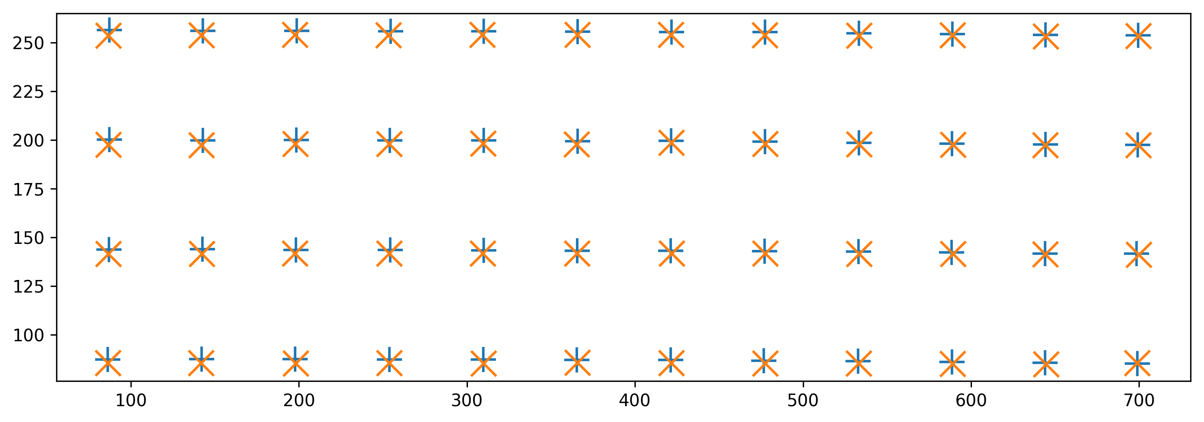
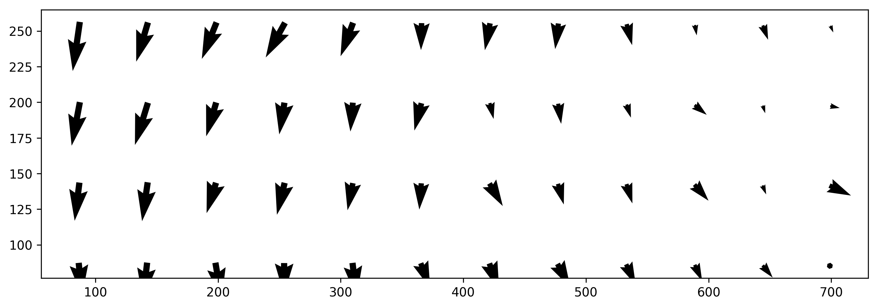
Pattern Statistics: delta G-R position

Slide 12
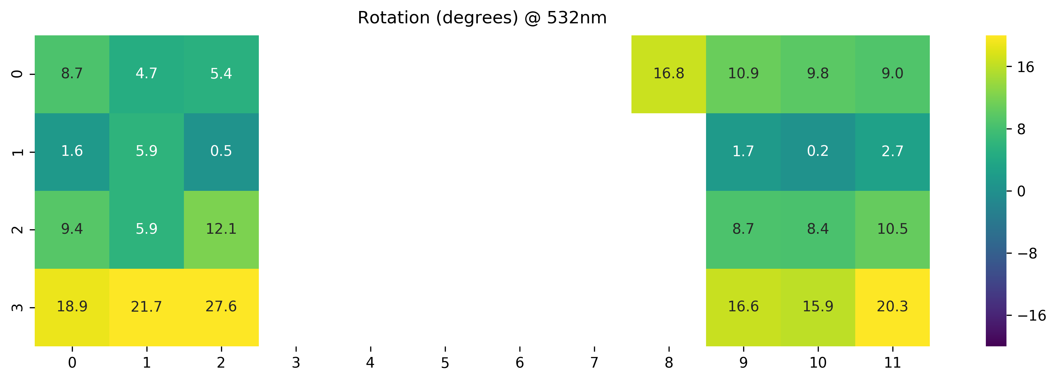
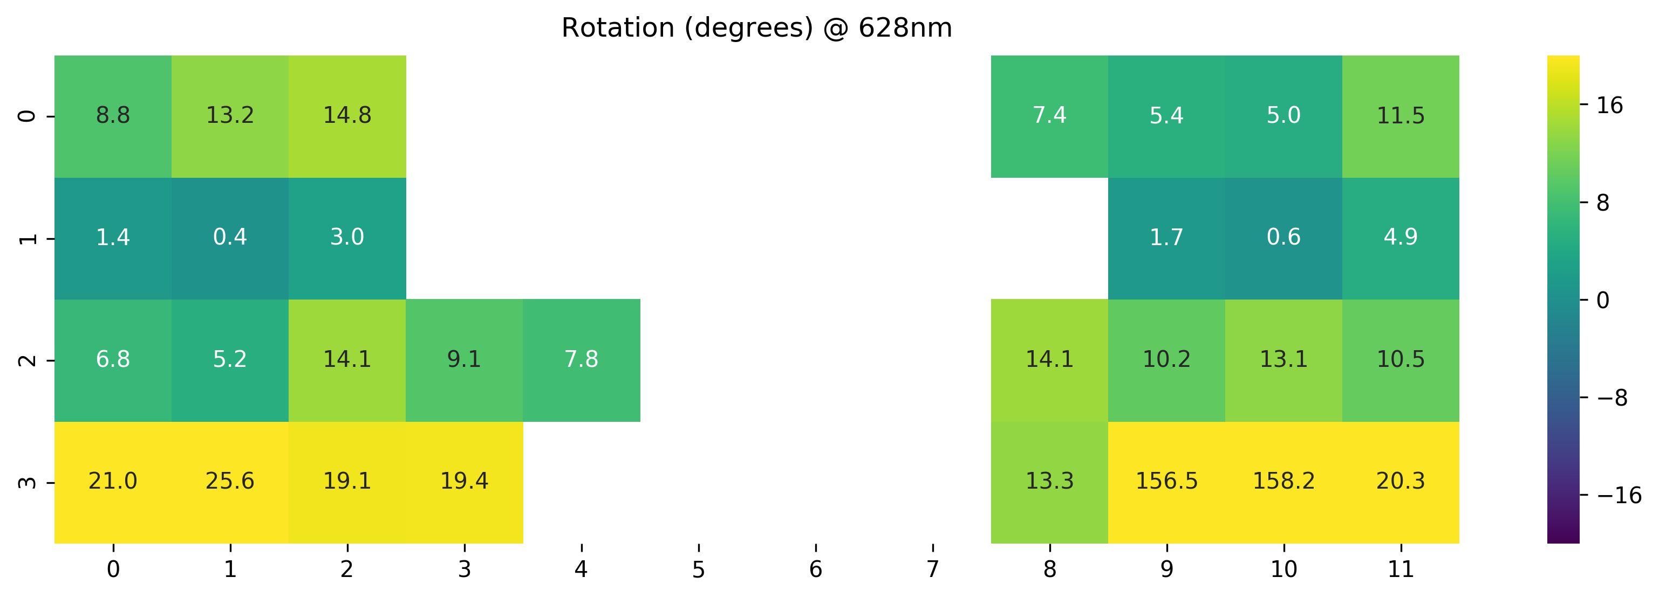
Pattern Statistics: PSF rotation distribution
Only spots with
σ_{x}/ σ_{y} > 1.2
Only spots with
σ_{x}/ σ_{y} > 1.2

Slide 13
48-spot smFRET
Single-laser excitation

Slide 14
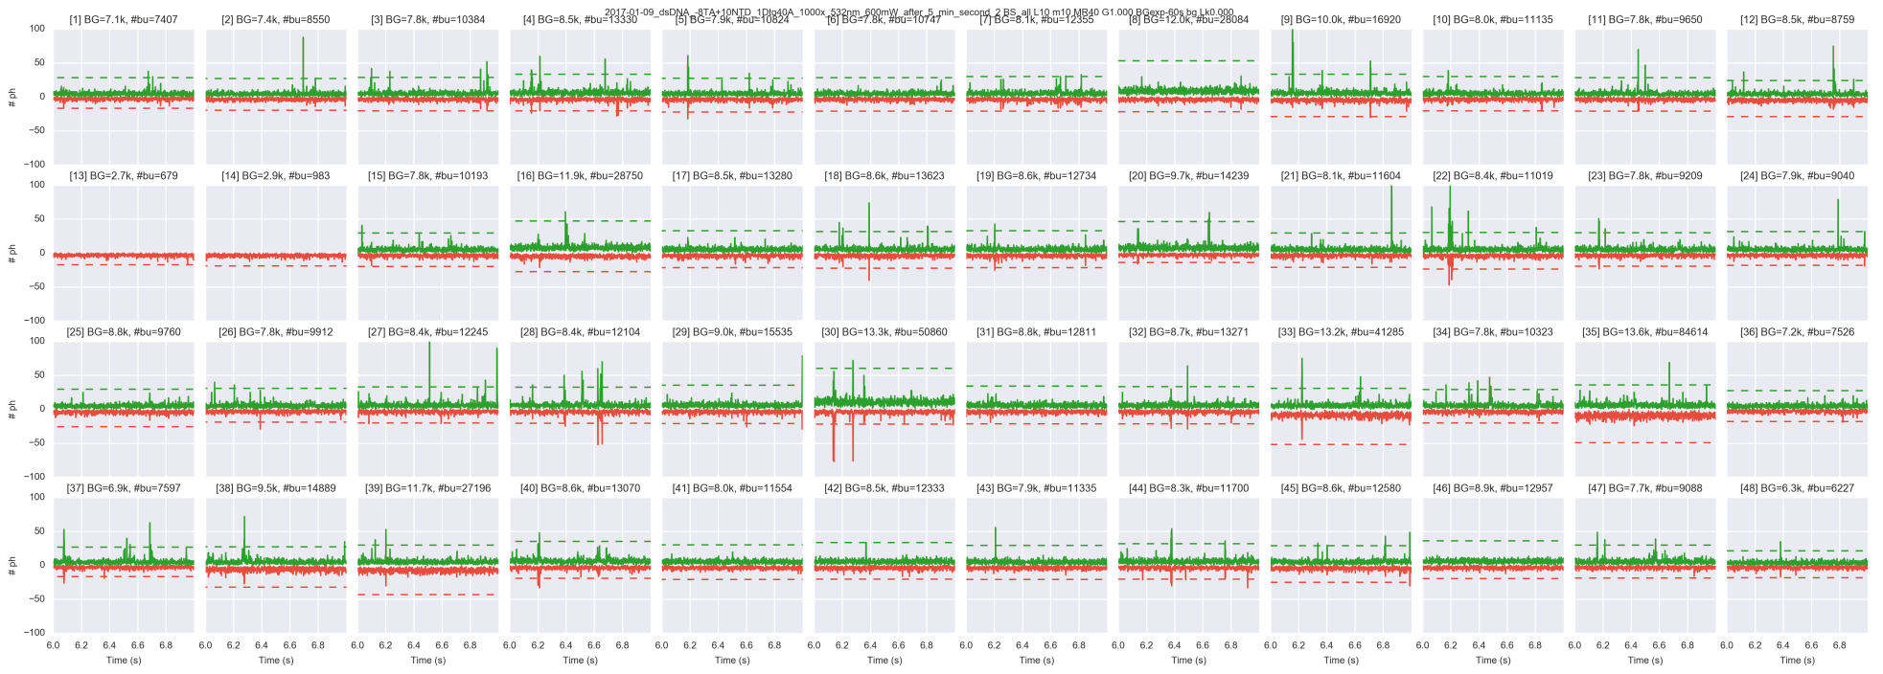
48-spot timetraces
dsDNA 18bp D-A distance

Slide 15
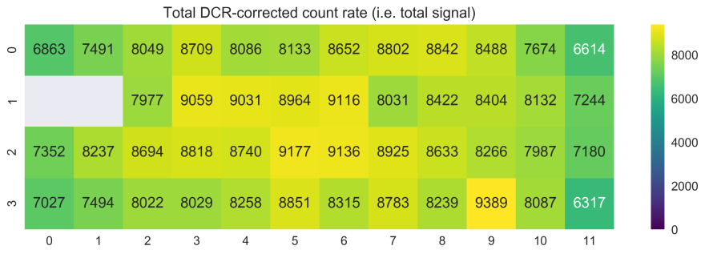
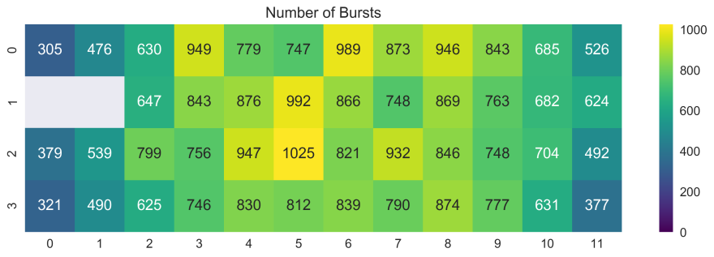
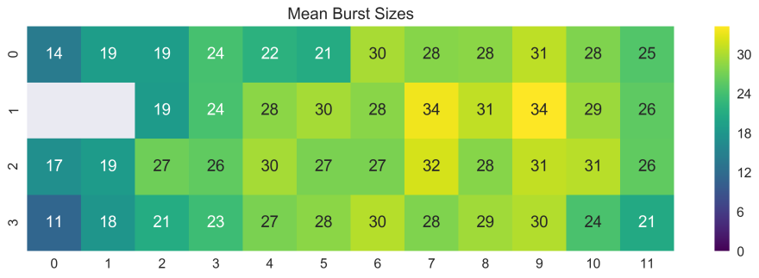
Spot Statistics
dsDNA 18bp D-A distance
Total DCR-corrected photon count-rate
Number of bursts
Mean burst sizes

Slide 16
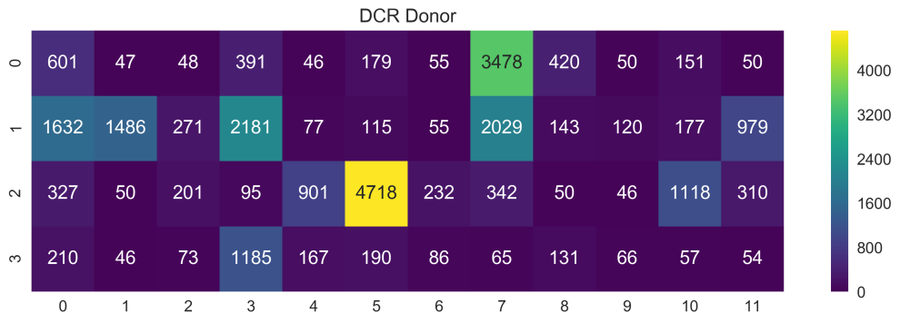
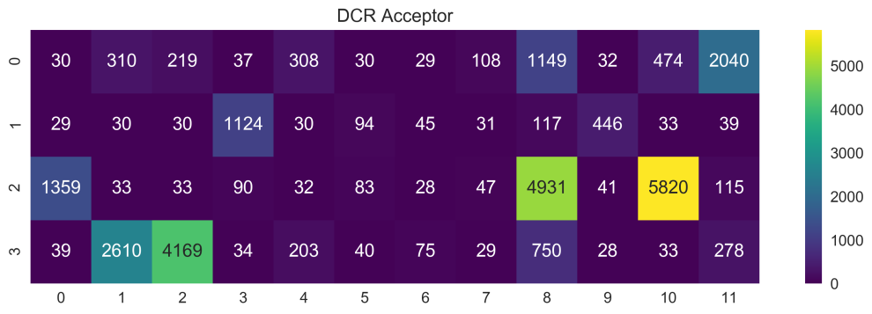
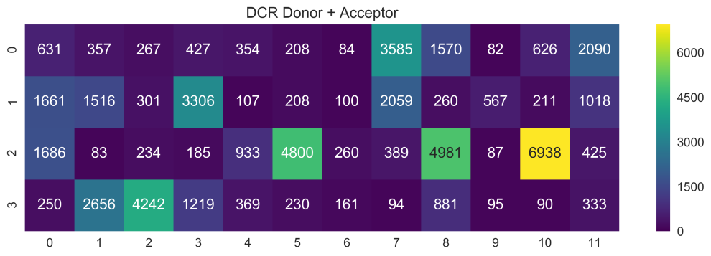
SPAD DCR
Donor
Acceptor
Donor + Acceptor

Slide 17

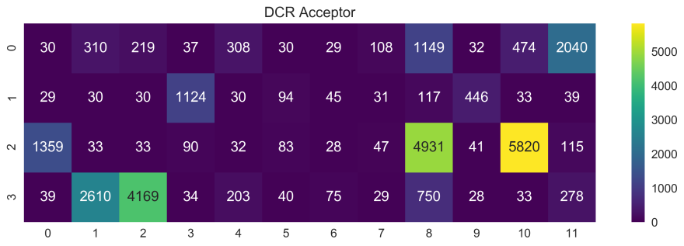

Spot Statistics
dsDNA 18bp D-A distance -smFRET

Slide 18
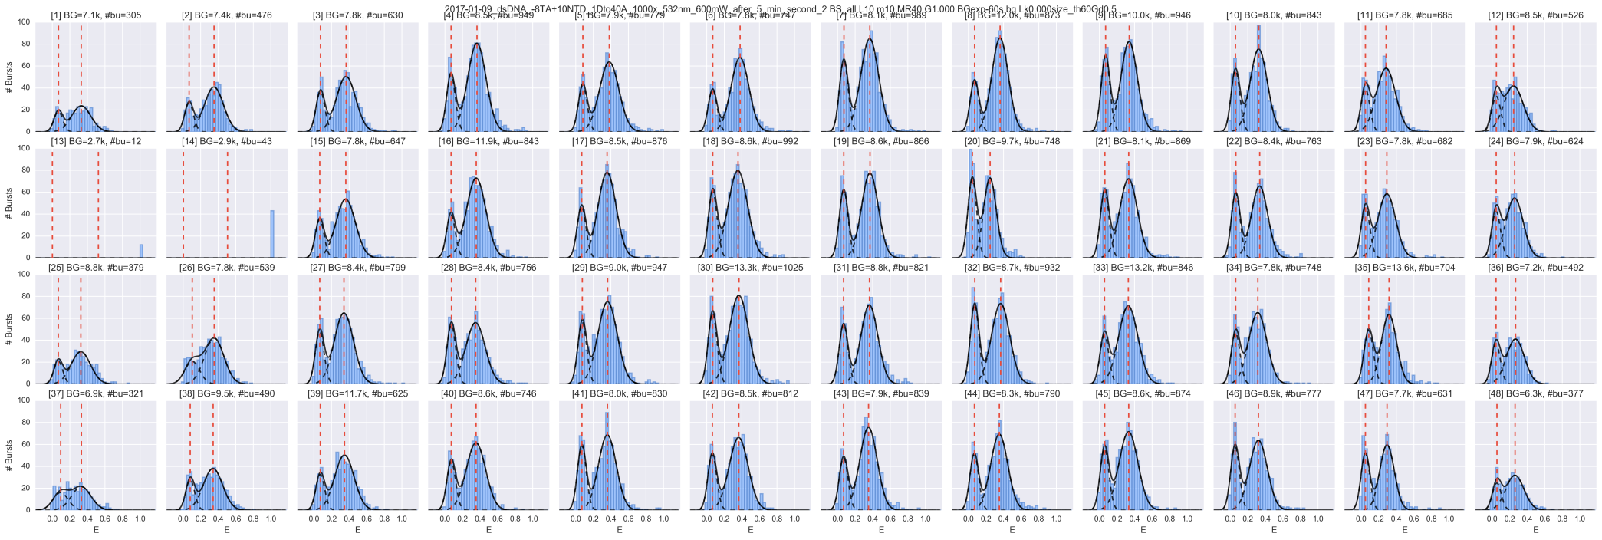
48-spot smFRET histograms
dsDNA 18bp D-A distance

Slide 19

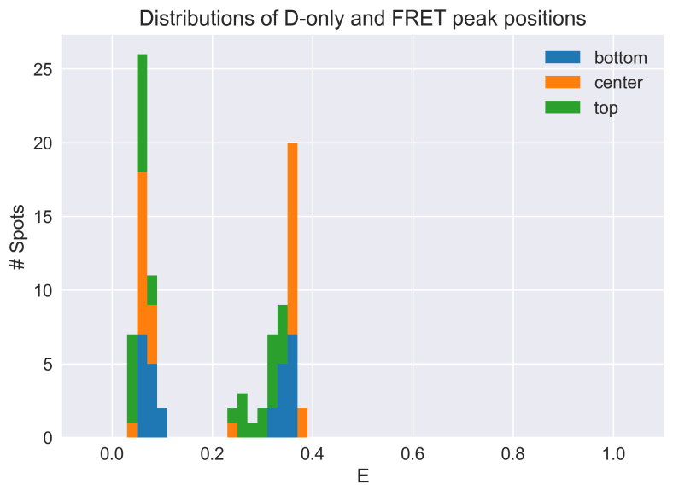
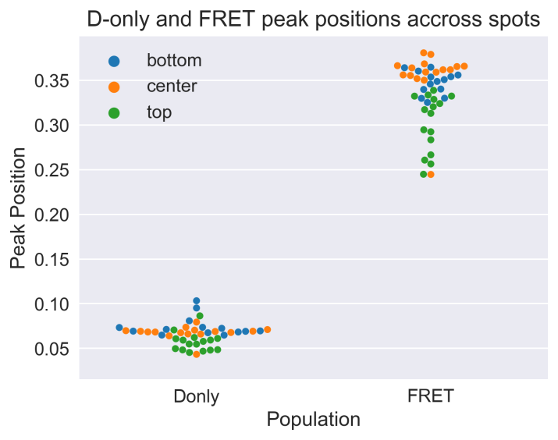
Spot Statistics
Pixel map
top
dsDNA 18bp D-A distance
center
Fitted D-only and FRET peak’s centers across 48-spots
bottom
Histogram
Swarm-plot
E1 mean [min, max] = 0.066 [0.043, 0.103], σ = 0.012
E2 mean [min, max] = 0.335 [0.245, 0.381], σ = 0.036

Slide 20
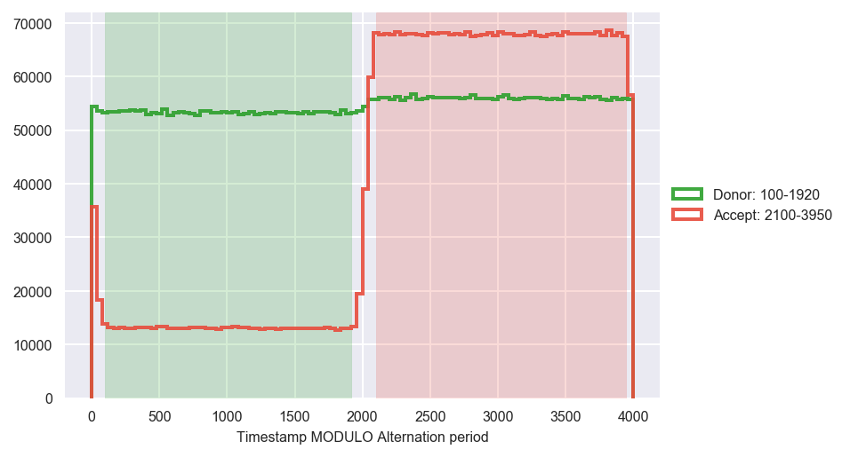
48-spot smFRET
2-laser excitation
AKA PAX

Slide 21
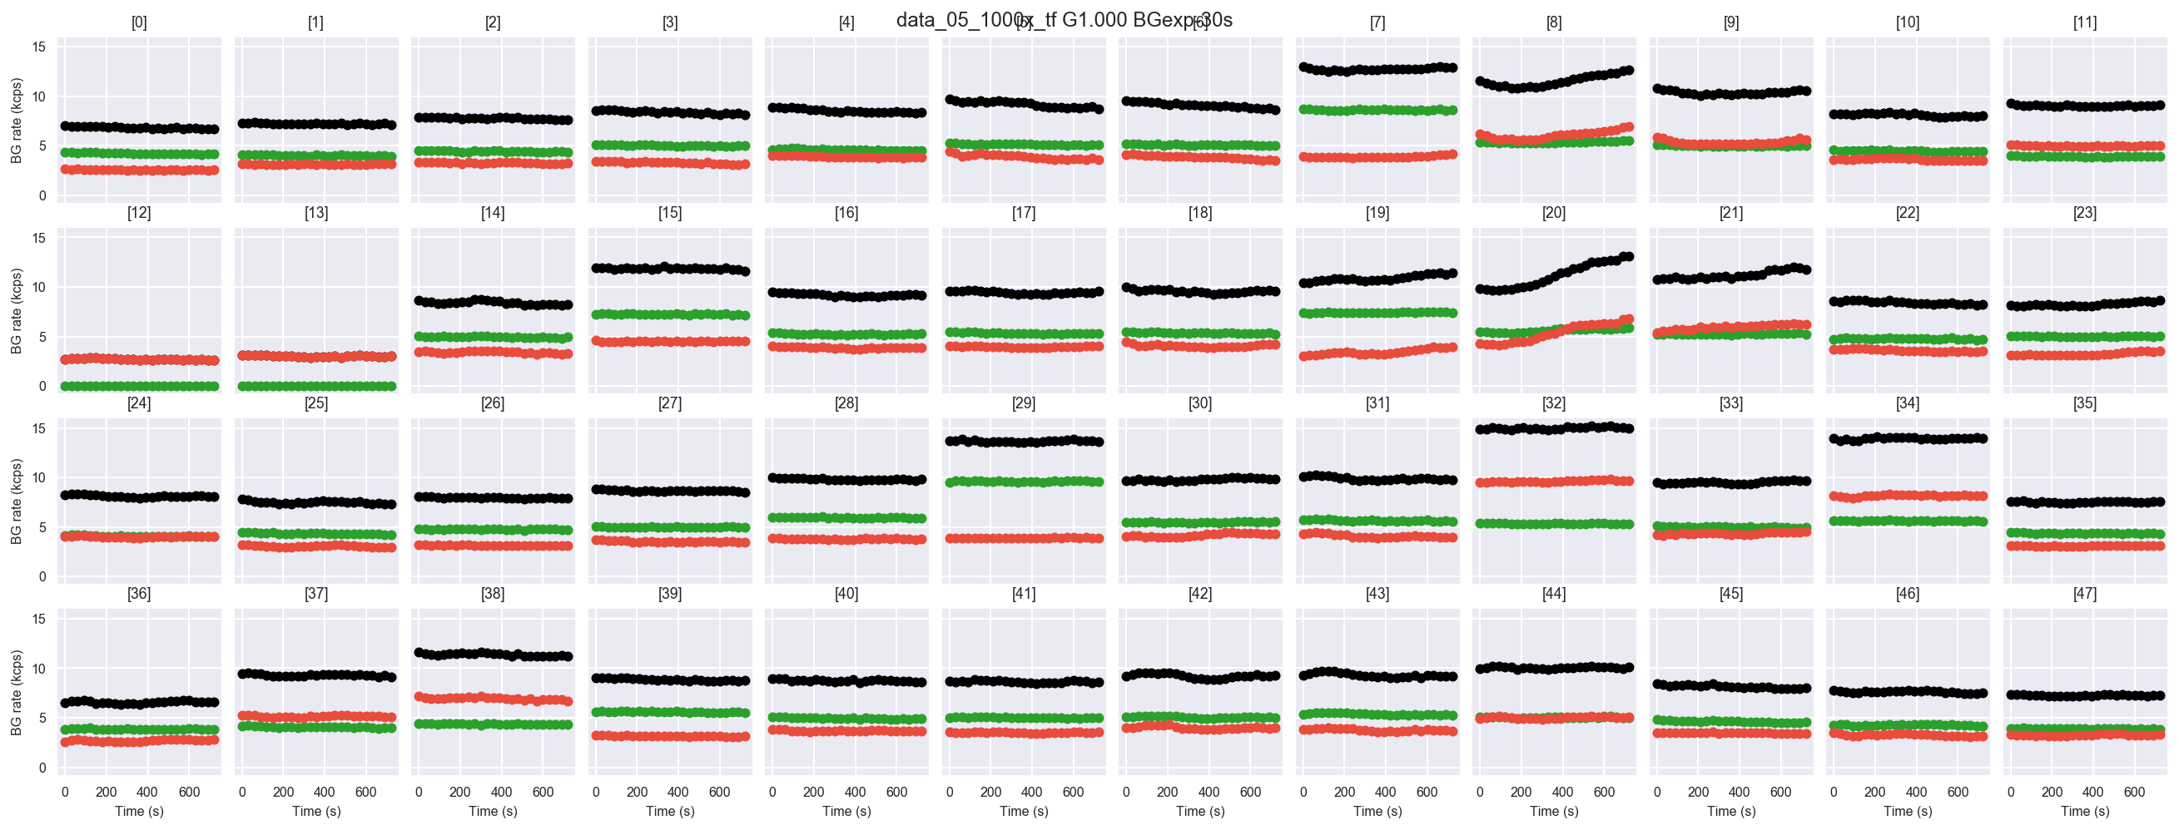

Slide 22
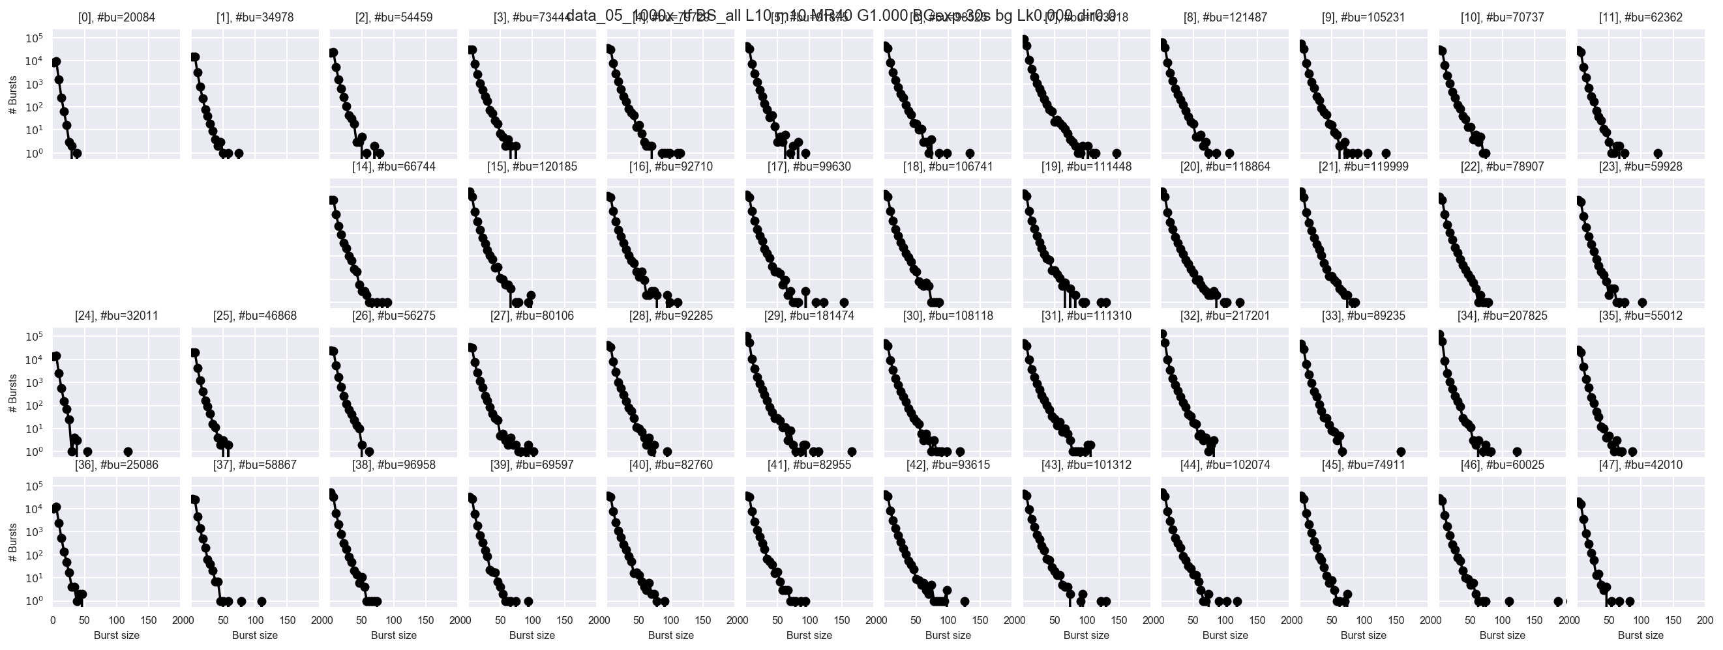
Size = F_{DD} + F_{DA} + F_{AD} + F_{AA}

Slide 23
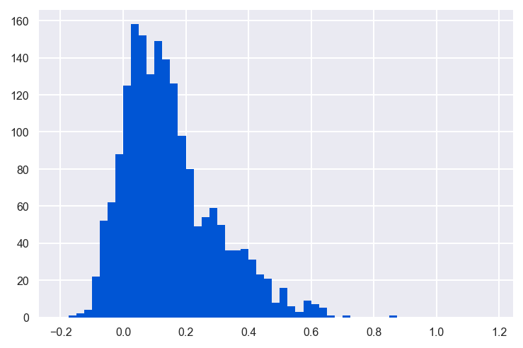
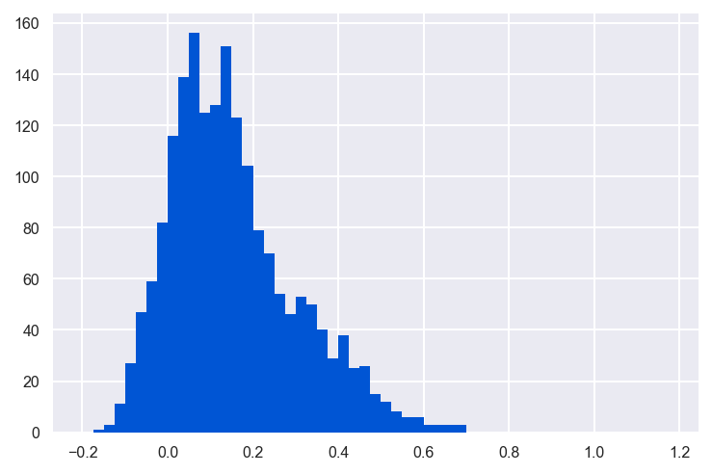
Dem/Aem: detection channel
Dex/Aex: alternation period
E = F_{AemDex} / (F_{AemDex} + F_{DemDex})
Dex
Aex
E = 2F_{AemDex} / (2F_{AemDex} + F_{dem})

Slide 24
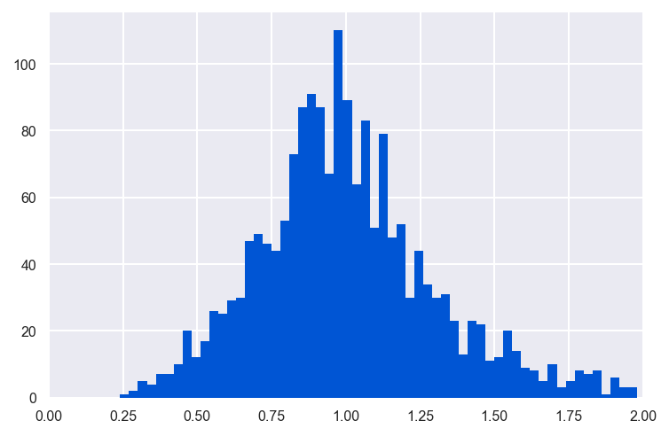
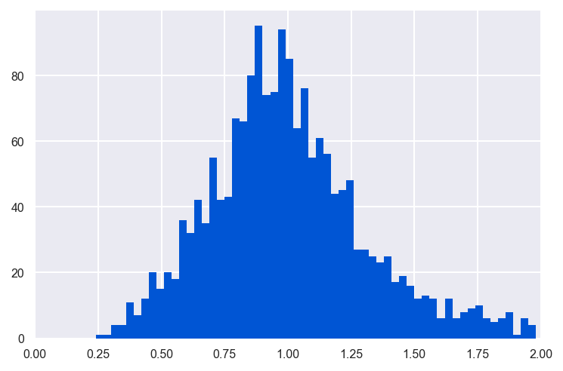
Dem/Aem: detection channel
Dex/Aex: alternation period
S = (F_{D} + F_{A}) / (F_{D} + F_{A} + F_{AA})
F_{AemAex}
PAX
Dex
Aex
S = (F_{DD} + F_{DA} + 2F_{A}) / (F_{DD} + F_{DA} + 2F_{A} + 2F_{AA})
2F_{AemAex}
PAX

Slide 25

E (uncorrected)

Slide 26

S (uncorrected)

Slide 27




ALEX Histograms
4 central
spots

Slide 28



Spot Statistics
dsDNA 18bp D-A distance - PAX

Slide 29
Near Future
Optimize and establish more formal alignment protocols
Acquire decent dsDNA data 48-spot smFRET-PAX
Write paper describing the 48-spot setup
Try a realtime kinetics measurement
Try hand-made flow-chamber

